Slide 1
JDBC
Java API for Database Connectivity
Reference Text:Y. Daniel Liang, Introduction to Java Programming, 7/e, Pearson, 2013.

Slide 2
What is an API?
Application Program Interface
a set of routines, protocols, and tools for building software applications
provides all the building blocks

Slide 3
JDBC
JDBC is the Java API for accessing relational database.
JDBC provides Java programmers with a uniform interface for accessing and manipulating relational databases.
Using the JDBC API, applications written in the Java programming language can execute SQL statements, retrieve results, present data in a user-friendly interface,and propagate changes back to the database.

Slide 4
The JDBC API can also be used to interact with multiple data sources in a distributed, heterogeneous environment.
Since a JDBC driver serves as the interface to facilitate communications between JDBC and a proprietary database, JDBC drivers are database specific and are normally provided by the database vendors.

Slide 5
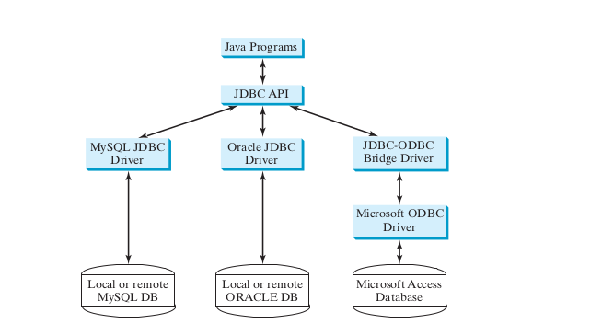

Slide 6
JDBC Architecture
The JDBC API supports both two-tier and three-tier processing models for database access but in general, JDBC Architecture consists of two layers −
JDBC API: This provides the application-to-JDBC Manager connection.
JDBC Driver API: This supports the JDBC Manager-to-Driver Connection.
The JDBC API uses a driver manager and database-specific drivers to provide transparent connectivity to heterogeneous databases.
The JDBC driver manager ensures that the correct driver is used to access each data source. The driver manager is capable of supporting multiple concurrent drivers connected to multiple heterogeneous databases.

Slide 7
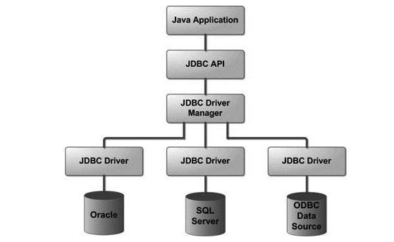

Slide 8
Big picture
Java Application
JDBC API
JDBC Manager
JDBC Driver API
JDBC Drivers
Grey Area
Data Sources

Slide 9
JDBC Driver
JDBC Driver is a software component that enables java application to interact with the database.There are 4 types of JDBC drivers:
Type1-JDBC-ODBC bridge driver
Type2-Native-API driver (partially java driver)
Type3-Network Protocol driver (fully java driver)
Type4-Thin driver (fully java driver)

Slide 10
Type1-JDBC-ODBC bridge driver
The JDBC-ODBC bridge driver uses ODBC driver to connect to the database.
The JDBC-ODBC bridge driver converts JDBC method calls into the ODBC function calls.
Advantages:
easy to use.
can be easily connected to any database.
Disadvantages:
Performance degraded because JDBC method call is converted into the ODBC function calls.
The ODBC driver needs to be installed on the client machine.

Slide 11
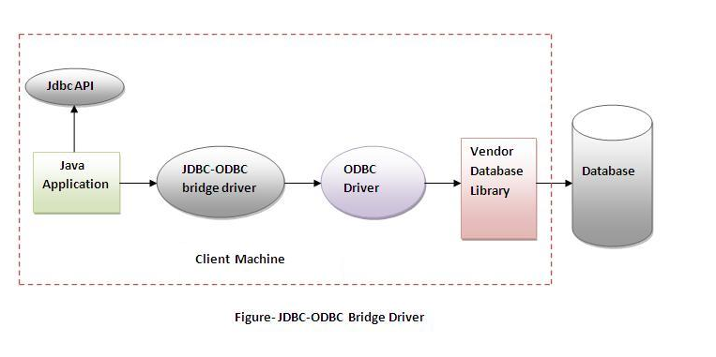

Slide 12
Type2-Native API driver
The Native API driver uses the client-side libraries of the database. The driver converts JDBC method calls into native calls of the database API. It is not written entirely in java.
Advantage:
performance upgraded than JDBC-ODBC bridge driver.
Disadvantage:
The Native driver needs to be installed on the each client machine.
The Vendor client library needs to be installed on client machine.

Slide 13
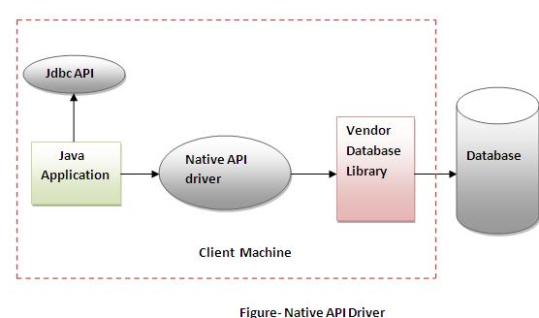

Slide 14
Type3-Network Protocol driver
In a Type 3 driver, a three-tier approach is used to access databases. The JDBC clients use standard network sockets to communicate with a middleware application server. The socket information is then translated by the middleware application server into the call format required by the DBMS, and forwarded to the database server. It is fully written in java.
Advantage:
No client side library is required because of application server that can perform many tasks like auditing, load balancing, logging etc.
Disadvantages:
Network support is required on client machine.
Requires database-specific coding to be done in the middle tier.
Maintenance of Network Protocol driver becomes costly because it requires database-specific coding to be done in the middle tier.

Slide 15
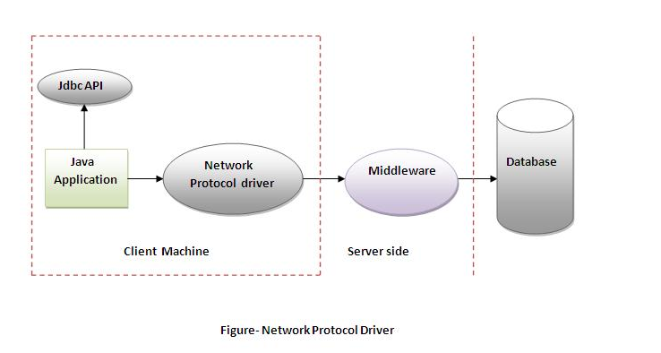

Slide 16
Type4-Thin driver(100% Pure Java)
The thin driver converts JDBC calls directly into the vendor-specific database protocol. That is why it is known as thin driver. It is fully written in Java language.
Eg:MySQL's Connector/J driver
Advantage:
Better performance than all other drivers.
No software is required at client side or server side.
Disadvantage:
Drivers depends on the Database.

Slide 17
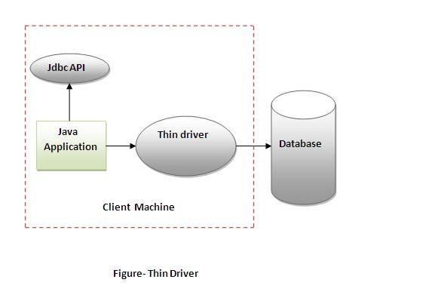

Slide 18
Developing Database Applications Using JDBC
The JDBC API consists of classes and interfaces for establishing connections with databases, sending SQL statements to databases, processing the results of SQL statements, and obtaining database metadata.

Slide 19
Four key interfaces are needed to develop any database application using Java: Driver , Connection , Statement , and ResultSet. These interfaces are in Java.sql package
These interfaces define a framework for generic SQL database access.
The JDBC API defines these interfaces, and the JDBC driver vendors provide the implementation for the interfaces.
Programmers use these interfaces.

Slide 20
A JDBC application loads an appropriate driver using the Driver interface,
connects to the database using the Connection interface,
creates and executes SQL statements using the Statement interface,
and processes the result using the ResultSet interface if the statements return results.
Note that some statements, such as SQL data definition statements and SQL data modification statements, do not return results.

Slide 21
JDBC Interface classes
Java.sql package
  DriverManager
  Connection
  Statement
  CallableStatement
  PreparedStatement
  Resultset
  ResultSetMetaData
  DatabaseMetaData

Slide 22
JDBC Interfaces
Driver Manager
Connection
Connection
Connection
Statement
Prepared
Statement
ResultSet

Slide 23
Typical JDBC Programming Procedure
1. Loading drivers
2. Establishing connections
3. Creating statements
4. Executing statements
5. Processing ResultSet

Slide 24
Loading Drivers
The purpose of the java.sql.DriverManger class in JDBC is to provide a common access layer on top of different database drivers used in an application.
DriverManager requires that each driver required by the application must be loaded before use, so that the DriverManager is aware of it.
An appropriate driver must be loaded using the statement shown below before connecting to a database.
Class.forName("JDBCDriverClass");
A driver is a concrete class that implements the java.sql.Driver interface.
Class.forName (“oracle.jdbc.driver.OracleDriver”);

Slide 25
Syntax of forName() method
public static void forName(String className)throws ClassNotFoundException
Example: Class.forName("oracle.jdbc.driver.OracleDriver");

Slide 26
JDBC Drivers
Access- sun.jdbc.odbc.JdbcOdbcDriver( Already in JDK)
MySQL-
com.mysql.jdbc.Driver (mysql-connector-java-5.1.26.jar)
Oracle-
oracle.jdbc.driver.OracleDriver (ojdbc6.jar)

Slide 27
Connecting to a Database
To connect to a database, use the static method getConnection(databaseURL) in the
DriverManager class, as follows:
Connection connection = DriverManager.getConnection(databaseURL);
where databaseURL is the unique identifier of the database on the Internet.
Syntax of getConnection() method
1) public static Connection getConnection(String url)throws SQLException
2) public static Connection getConnection(String url,String name,String password)
throws SQLException

Slide 28
Following are the the URL patterns for the Access, MySQL, and Oracle databases
Access- jdbc:odbc:dataSource
MySQL- jdbc:mysql://hostname/dbname
Oracle- jdbc:oracle:thin:@hostname:port#:oracleDBSID
Eg:
Class.forName("com.mysql.jdbc.Driver");
Connection con=DriverManager.getConnection(
"jdbc:mysql://localhost/DatabaseName","root","password");
Connection connection = DriverManager.getConnection
("jdbc:oracle:thin:@liang.armstrong.edu:1521:orcl",
"scott", "tiger");(ORACLE)

Slide 29
Creating statements
The createStatement() method of Connection interface is used to create statement. The object of statement is responsible to execute queries with the database.
you can create statements for executing SQL statements as follows:
Statement statement = connection.createStatement();
Syntax of createStatement() method
public Statement createStatement()throws SQLException
Creating a Coffee table
CREATE TABLE COFFEES (COF_NAME VARCHAR(32), SUP_ID INTEGER, PRICE FLOAT, SALES INTEGER, TOTAL INTEGER)
statements
Statement stmt = con.createStatement ();
Execute a statement
stmt.executeUpdate (“CREATE TABLE COFFEES “ + “(COF_NAME VARCHAR(32), SUP_ID INTEGER, PRICE FLOAT, “ + “SALES INTEGER, TOTAL INTEGER)”);

Slide 30
Execute Statements
SQL data definition language (DDL) and update statements can be executed using
executeUpdate(String sql) ,
and an SQL query statement can be executed using
executeQuery(String sql) .
The result of the query is returned in ResultSet .
03/27/18
© Wu, Lee & Offutt

Slide 31
For example, the following code executes the SQL statement
create table Temp (col1 char(5), col2 char(5)) :
statement.executeUpdate
("create table Temp (col1 char(5), col2 char(5))");
This next code executes the SQL query select firstName, mi, lastName from
Student where lastName = 'Smith' :
// Select the columns from the Student table
ResultSet resultSet = statement.executeQuery
("select firstName, mi, lastName from Student where lastName = 'Smith'");

Slide 32
Entering Data into a Table
  Statement stmt = con.createStatement();
  stmt.executeUpdate ( "INSERT INTO COFFEES " + "VALUES ('Colombian', 101, 7.99, 0, 0)");
  stmt.executeUpdate ( "INSERT INTO COFFEES " + "VALUES ('French_Roast', 49, 8.99, 0, 0)" );
  stmt.executeUpdate ( "INSERT INTO COFFEES " + "VALUES ('Espresso', 150, 9.99, 0, 0)" );
  stmt.executeUpdate ( "INSERT INTO COFFEES " + "VALUES ('Colombian_Decaf', 101, 8.99, 0, 0)" );
  stmt.executeUpdate ( "INSERT INTO COFFEES " + "VALUES ('French_Roast_Decaf', 49, 9.99, 0, 0)" );
03/27/18
© Wu, Lee & Offutt

Slide 33
Processing ResultSet
The ResultSet maintains a table whose current row can be retrieved.
The initial row position is null .
You can use the next method to move to the next row and the various getter methods to retrieve values from a current row.
03/27/18
© Wu, Lee & Offutt

Slide 34
For example, the following code displays all the results from the preceding SQL query.
// Iterate through the result and print the student names
while (resultSet.next())
System.out.println(resultSet.getString(1) + " " +
resultSet.getString(2) + " " + resultSet.getString(3));
The getString(1) , getString(2) , and getString(3) methods retrieve the column values for firstName , mi , and lastName , respectively.
Alternatively, you can use getString("firstName") , getString("mi") , and getString("lastName") to retrieve the same three column values.
The first execution of the next() method sets the current row to the first row in the result set, and subsequent invocations of the next() method set the current row to the second row, third row, and so on, to the last row.

Slide 35
SimpleJDBC.java
import java.sql.*;
public class SimpleJdbc {
public static void main(String[] args)
throws SQLException, ClassNotFoundException {
// Load the JDBC driver
Class.forName("com.mysql.jdbc.Driver");
System.out.println("Driver loaded");
// Connect to a database
Connection connection = DriverManager.getConnection
("jdbc:mysql://localhost/javabook" , "scott", "tiger");
System.out.println("Database connected");

Slide 36
// Create a statement
Statement statement = connection.createStatement();
// Execute a statement
ResultSet resultSet = statement.executeQuery
("select firstName, mi, lastName from Student where lastName = 'Smith'");
// Iterate through the result and print the student names
while (resultSet.next())
System.out.println(resultSet.getString(1) + "\t" +
resultSet.getString(2) + "\t" + resultSet.getString(3));
// Close the connection
connection.close();

Slide 37
PreparedStatement
PreparedStatement enables you to create parameterized SQL statements.
Once a connection to a particular database is established, it can be used to send SQL statements from your program to the database.
The Statement interface is used to execute static SQL statements that don’t contain any parameters.
The PreparedStatement interface, extending Statement , is used to execute a precompiled SQL statement with or without parameters.
Since the SQL statements are precompiled, they are efficient for repeated executions.

Slide 38
A PreparedStatement object is created using the prepareStatement method in the Connection interface.
For example, the following code creates a PreparedStatement for an SQL insert statement:
PreparedStatement preparedStatement = connection.prepareStatement ("insert into Student (firstName, mi, lastName) values (?, ?, ?)");
This insert statement has three question marks as placeholders for parameters representing values for firstName , mi , and lastName in a record of the Student table.

Slide 39
As a subinterface of Statement , the PreparedStatement interface inherits all the methods defined in Statement .
It also provides the methods for setting parameters in the object of PreparedStatement .
These methods are used to set the values for the parameters before executing statements or procedures.
In general, the setter methods have the following name and signature:
setX(int parameterIndex, X value);

Slide 40
where X is the type of the parameter, and parameterIndex is the index of the parameter in the statement. The index starts from 1 .
For example, the method setString(int parameterIndex, String value) sets a String value to the specified parameter.
The following statements pass the parameters "Jack" , "A" , and "Ryan" to the placeholders for firstName , mi , and lastName in preparedStatement :
preparedStatement.setString(1, "Jack");
preparedStatement.setString(2, "A");
preparedStatement.setString(3, "Ryan");

Slide 41
After setting the parameters, you can execute the prepared statement by invoking executeQuery() for a SELECT statement and executeUpdate() for a DDL or update statement.
The executeQuery() and executeUpdate() methods are similar to the ones defined in the Statement interface except that they don’t have any parameters, because the SQL statements are already specified in the prepareStatement method when the object of PreparedStatement is created.

Slide 42
import java.sql.*;
import java.io.*;
class MysqlCon{
public static void main(String args[]){
try{
Class.forName("com.mysql.jdbc.Driver");
Connection con=DriverManager.getConnection(
"jdbc:mysql://localhost:3306/FIRST","root","pwd");
String sql="select * from employee where empNo=? and name=?";

Slide 43
String sql="select * from employee where empNo=? and name=?";
PreparedStatement preparedStatement = con.prepareStatement(sql);
BufferedReader reader = new BufferedReader(new InputStreamReader(System.in));
System.out.print("Enter the Employee No: ");
String empNo = reader.readLine();
System.out.print("Enter the Name: ");
String name = reader.readLine();

Slide 44
preparedStatement.setString(1, empNo);
preparedStatement.setString(2, name);
ResultSet rs=preparedStatement.executeQuery();
while(rs.next())
System.out.println(rs.getInt(1)+" "+rs.getString(2)+" "+rs.getString(3));
con.close();
}catch(Exception e){ System.out.println(e);}
}
}

Slide 45
CallableStatement
CallableStatement enables you to execute SQL stored procedures
The CallableStatement interface is designed to execute SQL-stored procedures.
The procedures may have IN , OUT or IN OUT parameters. An IN parameter receives a value passed to the procedure when it is called. An OUT parameter returns a value after the procedure is completed, but it doesn’t contain any value when the procedure is called. An IN OUT parameter contains a value passed to the procedure when it is called and returns a value after it is completed.

Slide 46
For example, the following procedure in Oracle PL/SQL has IN parameter p1 ,OUT parameter p2 , and IN OUT parameter p3 .
create or replace procedure sampleProcedure (p1 in varchar, p2 out number, p3 in out integer) is
begin
/* do something */
end sampleProcedure;

Slide 47
A CallableStatement object can be created using the prepareCall(String call) method in the Connection interface.
For example, the following code creates a CallableStatement cstmt on Connection connection for the procedure sampleProcedure .
CallableStatement callableStatement = connection.prepareCall( "{call sampleProcedure(?, ?, ?)}");

Slide 48
{call sampleProcedure(?, ?, ...)} is referred to as the SQL escape syntax, which signals the driver that the code within it should be handled differently.
The driver parses the escape syntax and translates it into code that the database understands.
In this example,
sampleProcedure is an Oracle procedure. The call is translated to the string begin sampleProcedure(?, ?, ?); end and passed to an Oracle database for execution.

Slide 49
You can call procedures as well as functions. The syntax to create an SQL callable state-
ment for a function is:
{? = call functionName(?, ?, ...)}
CallableStatement inherits PreparedStatement .
Additionally, the CallableStatement interface provides methods for registering the OUT parameters and for getting values from the OUT parameters.

Slide 50
Before calling an SQL procedure, you need to use appropriate setter methods to pass values to IN and IN OUT parameters, and use registerOutParameter to register OUT and IN OUT parameters.
For example, before calling procedure sampleProcedure , the following statements pass values to parameters p1 ( IN ) and p3 ( IN OUT ) and register parameters p2 ( OUT ) and p3 ( IN OUT ):

Slide 51
callableStatement.setString(1, "Dallas");
callableStatement.setLong(3, 1);
callableStatement.registerOutParameter(2, java.sql.Types.DOUBLE);
callableStatement.registerOutParameter(3, java.sql.Types.INTEGER);
You can use execute() or executeUpdate() to execute the procedure depending on the
type of SQL statement, then use getter methods to retrieve values from the OUT parameters.
For example, the next statements retrieve the values from parameters p2 and p3 .
double d = callableStatement.getDouble(2);
int i = callableStatement.getInt(3);

Slide 52
DELIMITER $$
CREATE PROCEDURE getNameEmp
(IN EMP_ID VARCHAR(20), OUT EMP_FIRST VARCHAR(255))
BEGIN
SELECT name INTO EMP_FIRST
FROM employee
WHERE empNo = EMP_ID;
END $$
DELIMITER ;
CALL getName('0001',@name);

Slide 53
import java.sql.*;
import java.io.*;
class MysqlCon{
public static void main(String args[]){
try{
Class.forName("com.mysql.jdbc.Driver");
Connection con=DriverManager.getConnection(
"jdbc:mysql://localhost:3306/FIRST","root","pwd");
CallableStatement callableStatement = con.prepareCall("{call getNameEmp(?, ?)}");
BufferedReader reader = new BufferedReader(new InputStreamReader(System.in));
System.out.print("Enter the Employee No: ");
String empNo = reader.readLine();

Slide 54
callableStatement.setString(1, empNo);
callableStatement.registerOutParameter(2, Types.VARCHAR);
callableStatement.execute();
String name=callableStatement.getString(2);
System.out.println(name);
con.close();
}catch(Exception e){ System.out.println(e);}
}
}

Slide 55
Validate login credentials of a user
import java.sql.*;
import java.io.*;
class MysqlCon{
public static void main(String args[]){
try{
Class.forName("com.mysql.jdbc.Driver");
Connection con=DriverManager.getConnection("jdbc:mysql://localhost:3306/FIRST","root","pwd");
BufferedReader reader = new BufferedReader(new InputStreamReader(System.in));
System.out.print("Enter the User Name: ");
String username = reader.readLine();
System.out.print("Enter the password ");
String password = reader.readLine();

Slide 56
pt = con.prepareStatement("select userName,password from user where userName=?");
// process query results
pt.setString(1, username);
ResultSet rs = pt.executeQuery();
String orgUname = "", orPass = "";
while (rs.next()) {
orgUname = rs.getString("userName");
orPass = rs.getString("password");
} //end while
if (orPass.equals(password)) {
System.out.println("Login credentials are verified");
} else {
System.out.println("Invalid login");
}
con.close();
}catch(Exception e){ System.out.println(e);}
}
}

